Slide 1
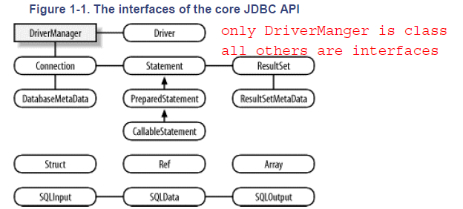

Slide 2
For non-sun JVM
Register JDBC Driver
Class.forName(“fqn”)
DriverManger.RegisterDriver()
Class.forName(“”).getInstance()

